Slide 1
Module 6
Python Bindings to C Libraries
Notes:
While Python is a wonderful language for writing applications, it is certainly slower than natively compiled code such as the C programming language. There are times when we'll want to call functions that are written in C for both performance and accessibility reasons.
We'll look at a python library called ctypes which we will use to call libraries and functions written in C.
This method uses Python's Foreign Function Interface library to allow us to directly call functions from a C shared library. In Windows, this is called a Dynamic Link Library.

Slide 2
Using ctypes
We have created a C shared library called libmymath.so
This contains a number of computationally expensive mathematics formulae
Including a calculation of a Fibonacci sequence
Notes:
Using ctypes
Let's look at an example.
Here we have created a C shared library called libmymath.so. This library contains a number of computationally expensive mathematics formulae, including the fibonacci sequence calculation. Let's take a look at a Python program that does two things:
1. It calculates the fibonacci sequence on its own in Python
It calls the libmymath.so file, written in C, to do the same calculation
It also benchmarks the two functions using the timeit module.

Slide 3
The Program
#!/usr/bin/python3.5
import timeit
from ctypes import *
def fib(n):
if n == 0:
return 0
elif n == 1:
return 1
else:
return(fib(n-1) + fib(n-2))
if __name__ == "__main__":
l = cdll.LoadLibrary("./libmymath.so")
for i in range(10):
t = timeit.Timer(lambda: fib(c_int(i).value))
print ('Pure python %.2f usec/pass' % (1000000 * t.timeit(number=100000)/100000))
t1 = timeit.Timer(lambda: l.fib(i))
print ('Ctypes python %.2f usec/pass' % (1000000 * t1.timeit(number=100000)/100000)
Notes:
First let’s look at the code.
Here we see that we've declared a function fib, which calculates the sum of the first n numbers of the sequence in Python. We're also going to use ctypes to call the libmymath.so fib function to do the same thing.
#!/usr/bin/python3.5
import timeit
from ctypes import *
def fib(n):
if n == 0:
return 0
elif n == 1:
return 1
else:
return(fib(n-1) + fib(n-2))
if __name__ == "__main__":
l = cdll.LoadLibrary("./libmymath.so")
for i in range(10):
t = timeit.Timer(lambda: fib(c_int(i).value))
print ('Pure python %.2f usec/pass' % (1000000 * t.timeit(number=100000)/100000))
t1 = timeit.Timer(lambda: l.fib(i))
print ('Ctypes python %.2f usec/pass' % (1000000 * t1.timeit(number=100000)/100000))

Slide 4
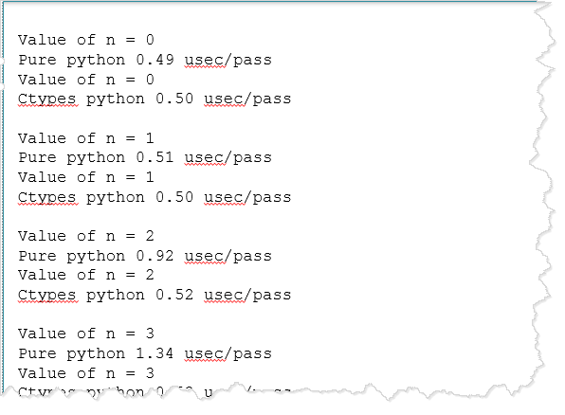
The Output
This is partial output
Notes:
Let's examine the output of this program.
Value of n = 0
Pure python 0.49 usec/pass
Value of n = 0
Ctypes python 0.50 usec/pass
Value of n = 1
Pure python 0.51 usec/pass
Value of n = 1
Ctypes python 0.50 usec/pass
Value of n = 2
Pure python 0.92 usec/pass
Value of n = 2
Ctypes python 0.52 usec/pass
Value of n = 3
Pure python 1.34 usec/pass
Value of n = 3
Ctypes python 0.53 usec/pass
Value of n = 4
Pure python 2.07 usec/pass
Value of n = 4
Ctypes python 0.55 usec/pass
Value of n = 5
Pure python 3.23 usec/pass
Value of n = 5
Ctypes python 0.58 usec/pass
Value of n = 6
Pure python 5.20 usec/pass
Value of n = 6
Ctypes python 0.64 usec/pass
Value of n = 7
Pure python 8.64 usec/pass
Value of n = 7
Ctypes python 0.72 usec/pass
Value of n = 8
Pure python 13.95 usec/pass
Value of n = 8
Ctypes python 0.84 usec/pass
Value of n = 9
Pure python 26.26 usec/pass
Value of n = 9
Ctypes python 1.03 usec/pass

Slide 5
Using ctypes
For small values for n, the performance of pure Python and the ctypes call is similar
As n gets larger the computation gets more expensive
So calling the c function produces quite dramatic performance increases
We call a method LoadLibrary() from the cdll class
This is part of the ctypes module
We pass in the path to the desired shared object as the argument to the LoadLibrary method.
We can then call functions on that library as we would call a Python method, by using the '.' operator
Notes:
Note that for small values for n, the performance of the pure Python and the ctypes call is quite similar. However, as n gets larger, and the computation gets more expensive, calling the c function produces quite dramatic performance increases.
If we examine the program, we see that we call a method LoadLibrary() from the cdll class which is part of the ctypes module. We pass in the path to the desired shared object as the argument to the LoadLibrary method. We can then call functions on that library as we would call a Python method, by using the '.' operator.

Slide 6
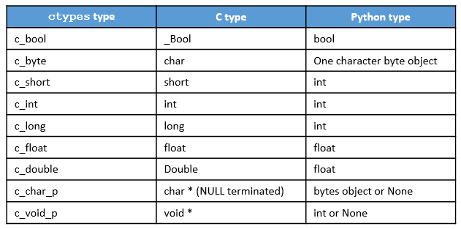
Some ctypes
ctypes defines a number of intrinsic types that map to Python objects
Here is a small sampling of them
Notes:
Ctypes defines a number of intrinsic types that map to Python objects. Here is a small sampling of them.
This is an incomplete list. For the full table of C to Python intrinsic mappings refer to the Python.org documentation on ctypes.

Slide 7
Passing Pointers via ctypes
We can also pass pointers via ctypes
We have defined the C function divide() in our mymath library
Takes three parameters (int a, int b and float*remainder)
Returns an integer result and a floating point remainder
Using the fmod() function from the C math library
Here's how we would pass the floating point value into the C function
#!/usr/bin/python3.5
import timeit
from ctypes import *
if __name__ == "__main__":
l = cdll.LoadLibrary("./libmymath.so")
div = l.divide
div.argtypes = [c_int, c_int,POINTER(c_float)]
x = c_int(3)
y = c_int(10)
remainder =c_float(0)
result = div(x.value,y.value,byref(remainder))
print ("result = %d remainder = %f" % (c_int(result).value,remainder.value))
Notes:
We can also pass pointers via ctypes.
Consider the following C function divide() which we have defined in our mymath library as taking three parameters (int a, int b and float * remainder) and returning an integer result and a floating point remainder using the fmod() function from the C math library.
Here's how we would pass the floating point value into the C function.
#!/usr/bin/python3.5
import timeit
from ctypes import *
if __name__ == "__main__":
l = cdll.LoadLibrary("./libmymath.so")
div = l.divide
div.argtypes = [c_int, c_int,POINTER(c_float)]
x = c_int(3)
y = c_int(10)
remainder =c_float(0)
result = div(x.value,y.value,byref(remainder))
print ("result = %d remainder = %f" % (c_int(result).value,remainder.value))

Slide 8
Examining the Program
We have an attribute called argtypes to the div object
Which is a function pointer to the divide function in the C library
We can use this attribute to specify what arguments will be passed to the divide function
Note that the third one is specified as a pointer to a float
The POINTER(c_float) statement
We declare a variable called remainder as a floating point number
Then pass it by reference into the divide function
The byref(remainder) statement
Notes:
Let's look at this program.
We note that we have an attribute to the div object (which is a function pointer to the divide function in the C library) called argtypes. We can use this attribute to specify what arguments will be passed to the divide function. Note that the third one is specified as a pointer to a float (The POINTER(c_float) statement).
We declare a variable called remainder as a floating point number and then pass it by reference into the divide function (the byref(remainder) statement).

